Slide 1
Session 21 : Event Handling
Module 4.3 : Android

Slide 2
Learning Objectives
At the end of the session successful participants will be able to
Understand Android Event handling
Implement an Event Handling Example
Design the User Interface
Understand the Event Listener and Callback Method
Consume Events

Slide 3
Widget : Views that have events
For a list of the widgets provided by Android, see the android.widget package.
Some Examples
Button
CheckBox
DatePicker
EditText
ImageView
SearchView
Spinner

Slide 4
Event Handling
Decide what Widgets who’s events to process
Define an event listener and register it with the View.
View.OnClickListener (for handling "clicks" on a View), View.OnTouchListener (for handling touch screen events in a View), and View.OnKeyListener (for handling device key presses within a View)
http://developer.android.com/guide/topics/ui/ui-events.html details more

Slide 5
Using Eclipse --lets recall our example from our starting lecture
“Hello World Project”
Lets add a button

Slide 6
Lets add a Button to a program-based interface
Step 1: Add button
Step 2: Register Event Handler
TWO OPTIONS – separate class to handle event(s), OR have the Activity containing the button do the event handling
Step 3: Implement Event Handler…for a Button means implementing the View.OnClickListener interface

Slide 7
Event handling done by Activity itself
Here code to handle is inside Activity itself
public class ExampleActivity extends Activity implements OnClickListener { protected void onCreate(Bundle savedValues) { ...
Button button = (Button)findViewById(R.id.corky); //STEP 1 button.setOnClickListener(this); //STEP 2 - registration } // Implement the OnClickListener callback //STEP 3 –event handler public void onClick(View v) { // do something when the button is clicked } ... }

Slide 8
Event Handling - here have a SEPARATE class
EVENT HANDLING CODE in separate object mCorkyListner
// Create an anonymous implementation of OnClickListener STEP 3 private OnClickListener mCorkyListener = new OnClickListener() { public void onClick(View v) { // do something when the button is clicked } };
//Now inside your Activity class protected void onCreate(Bundle savedValues) { ... // STEP 1: Capture our button from layout Button button = (Button)findViewById(R.id.corky); // STEP 2: Register the onClick listener with the implementation above button.setOnClickListener(mCorkyListener); ... }

Slide 9
Lets do it step by step
Depends on IDE…lets look at Eclipse

Slide 10
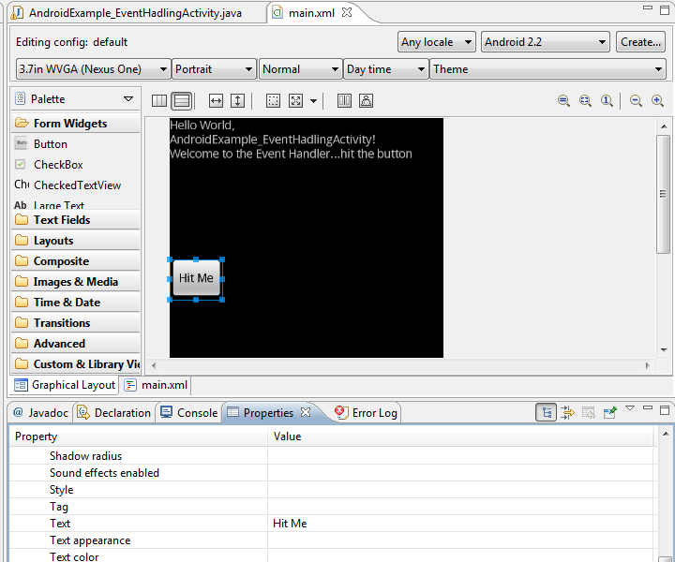
STEP1: Create a Button
Create button using XML GUI interface in Eclipse
Set property so label on button is “Hit Me”
Also, added text view with instructions telling user to hit button

Slide 11
STEP2: Register the main Application Activity as EventHandler for button
Grab button associated with its id, store in local variable b.
Call setonClickListener(this)
public class AndroidExample_EventHadlingActivity extends Activity implements OnClickListener {
int hits =0;
/** Called when the activity is first created. */
@Override
public void onCreate(Bundle savedInstanceState) {
super.onCreate(savedInstanceState);
setContentView(R.layout.main);
Button b = (Button)findViewById(R.id.button1);
b.setOnClickListener(this);
}
\

Slide 12
STEP2: Register the main Application Activity as EventHandler for button
Have the main class “AndroidExample_eventHandlingActivity” implement OnClickListener for button
In method onClick increment hits and use in display string.
public class AndroidExample_EventHadlingActivity extends Activity implements OnClickListener {
int hits =0;
/** Called when the activity is first created. */
@Override
public void onCreate(Bundle savedInstanceState) {
//see previous slide……..
}
// Implement the OnClickListener callback
//STEP 3 –event handler
public void onClick(View v) {
// do something when the button is clicked
this.hits++;
TextView text = (TextView)findViewById(R.id.textView1);
String s = "You hit me " + this.hits;
text.setText(s);
}
}

Slide 13
Run your code
Lets run the previous code.

Slide 14
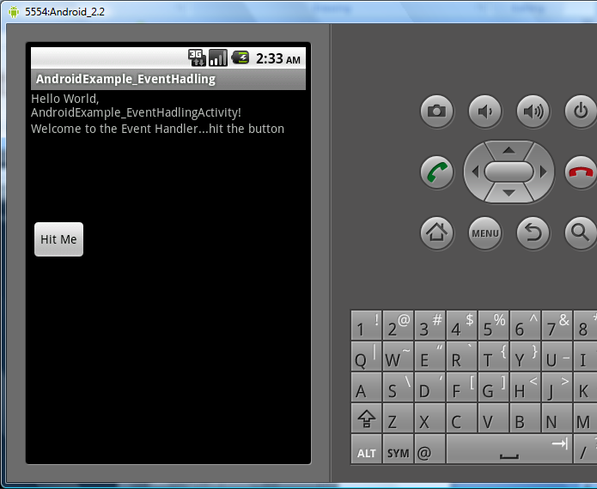
After running it—before hit button

Slide 15
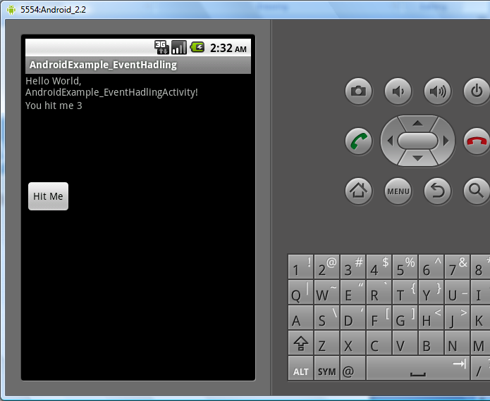
After hitting button a few times

Slide 16
What can you do with Event Handling
….your imagination is the limit…..

Slide 17
Remember …….Widget : Views that have events
For a list of the widgets provided by Android, see the android.widget package.
Some Examples
Button
CheckBox
DatePicker
EditText
ImageView
SearchView
Spinner

